Slide 1
MONEY MATTER : A PERSONAL FINANCE
MANAGEMENT APP PROJECT
By
Rakesh.M
Mohamed masthan.N
Pragadeeshwaran.G
Prakash.M

Slide 2
DESCRIPTION
personal finance management app project is designed to help users monitor, organize, and optimize their financial activities. The app should offer features that simplify budgeting, expense tracking, savings management, and financial goal setting. Here's a detailed description of such a project:
CODE FEATURES
Budget Tracking: Users can create and manage budgets for different spending categories (e.g., groceries, transportation, dining).Expense Tracking: The app allows users to record daily expenses either manually or through linked bank accounts for automated transaction tracking.Income Management: Users can input income sources and monitor their cash flow to ensure they stay within their means.Financial Goals: Users can set short-term and long-term savings goals (e.g., vacation funds, emergency savings) and track progress over time.

Slide 3
SOURCE CODE
Package com.example.expensestracker
Import android.content.Context
Import android.content.Intent
Import android.os.Bundle
Import androidx.activity.ComponentActivity
Import androidx.activity.compose.setContent
Import androidx.compose.foundation.Image
Import androidx.compose.foundation.layout.*
Import androidx.compose.material.*
Import androidx.compose.runtime.*
Import androidx.compose.ui.Alignment
Import androidx.compose.ui.Modifier
Import androidx.compose.ui.graphics.Color
Import androidx.compose.ui.layout.ContentScale

Slide 4
Import androidx.compose.ui.res.painterResource
Import androidx.compose.ui.text.font.FontFamily
Import androidx.compose.ui.text.font.FontWeight
Import androidx.compose.ui.text.input.PasswordVisualTransformation
Import androidx.compose.ui.text.input.VisualTransformation
Import androidx.compose.ui.tooling.preview.Preview
Import androidx.compose.ui.unit.dp
Import androidx.compose.ui.unit.sp
Import androidx.core.content.ContextCompat
Import com.example.expensestracker.ui.theme.ExpensesTrackerTheme

Slide 5
Class LoginActivity : ComponentActivity() {
Private lateinit var databaseHelper: UserDatabaseHelper
Override fun onCreate(savedInstanceState: Bundle?) {
Super.onCreate(savedInstanceState)
databaseHelper = UserDatabaseHelper(this)
setContent {
ExpensesTrackerTheme {
// A surface container using the ‘background’ color from the theme
Surface(
Modifier = Modifier.fillMaxSize(),
Color = MaterialTheme.colors.background
) {
LoginScreen(this, databaseHelper)
}

Slide 6
@Composable
Fun LoginScreen(context: Context, databaseHelper: UserDatabaseHelper) {
Image(
painterResource(id=R.drawable.img_1), contentDescription = “”,
alpha =0.3F,
contentScale = ContentScale.FillHeight,
)
Var username by remember { mutableStateOf(“”) }
Var password by remember { mutableStateOf(“”) }
Var error by remember { mutableStateOf(“”) }
Column(
Modifier = Modifier.fillMaxSize(),
horizontalAlignment = Alignment.CenterHorizontally,
verticalArrangement = Arrangement.Center
) {

Slide 7
color = Color.White,
text = “Login”
)
Spacer(modifier = Modifier.height(10.dp)
TextField(
Value = username,
onValueChange = { username = it },
label = { Text(“Username”) },
modifier = Modifier.padding(10.dp)
.width(280.d )
TextField(
Value = password,
onValueChange = { password = it },
label = { Text(“Password”) },
modifier = Modifier.padding(10.dp)
.width(280.dp)

Slide 8
If (error.isNotEmpty()) {
Text(
Text = error,
Color = MaterialTheme.colors.error,
Modifier = Modifier.padding(vertical = 16.dp)
)
}
Button(
onClick = {
if (username.isNotEmpty() && password.isNotEmpty()) {
val user = databaseHelper.getUserByUsername(username)
if (user != null && user.password == password error = “Successfully log in”
context.startActivity(

Slide 9
MainActivity::class.java
)
)
//onLoginSuccess()
}
Else {
Error = “Invalid username or password”
}
} else {
Error = “Please fill all fields”
}
},
Modifier = Modifier.padding(top = 16.dp)
) {
Text(text = “Login”)

Slide 10
}
Row {
TextButton(onClick = {context.startActivity(
Intent(
Context,
RegisterActivity::class.java
)
)}
)
{ Text(color = Color.White,text = “Sign up”) }
TextButton(onClick = {
})
{
Spacer(modifier = Modifier.width(60.dp))
Text(color = Color.White,text = “Forget password?”)

Slide 11
}
}
}
Private fun startMainPage(context: Context) {
Val intent = Intent(context, MainActivity::class.java)
ContextCompat.startActivity(context, intent, null)
}

Slide 12
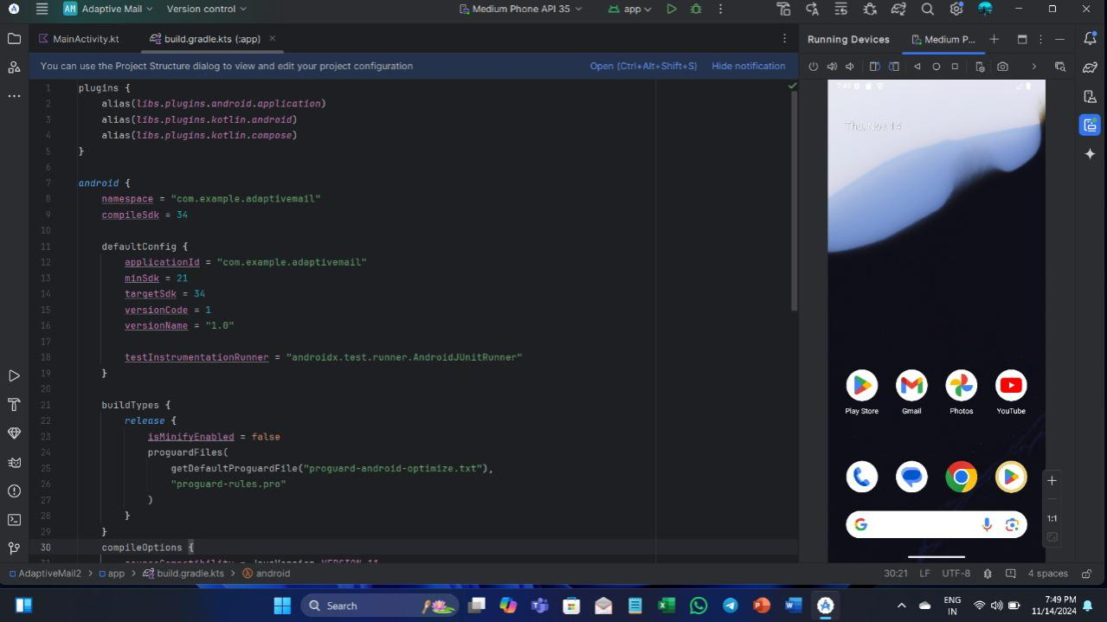
OUTPUT

Slide 13
